Slide 2
The Big 3 in Retail
Design (meaning the premises)
Merchandising (whatever you sell or use to sell)
Operations (staff, vendors)
Notes:
Risk, shoppers, vendors

Slide 3
Festival management courses
EXERCISE 3: DESIGN THE FESTIVAL LAYOUT
Place 20 drink stands, 20 food stands, 8 toilets, 3 music stages in order to create maximal
a) flow of people,
b) profit for all stands,
c) n° happy people,
d) security.
Hand-In: 1 Keynote/Powerpoint slide or PDF with your layout, 1 (or more) sentence(s) that explains your intention, with the drink stands, food stands, toilets, stages.

Slide 4
SO: measure your location based on:
Vendors
Things to consider: neighbors, weather, safety, transport/parking
Shoppers
Things to consider: flow, shoppability, meeting spaces (100% locations), transport/parking
Risk
Things to consider: safety, leaky entrances, topography
Notes:
Safety includes handicapped-accessible, likelihood of car accidents, snatch and grabs

Slide 5
100 percent location
“On maps of the corners we plotted the location of each conversation and how long it lasted. To our surprise, the people who stopped to talk did not move out of the main pedestrian flow; and if they had been out of it, they moved into it. The great bulk of the conversations were smack in the middle of the pedestrian flow—the 100 percent location, to borrow the real estate term.
Of 133 conversations we mapped over several days, 57 percent were concentrated in the highest-traffic locations.”
The Social Life of the Street William H. Whyte, Paco Underhill
Notes:
Where are your 100 percent locations? How do you allow them to happen?

Slide 6
X or Plus; rows; racetrack
X or Plus grid
Parallel rows, sometimes L shape
Closed Loop or Racetrack
Notes:
Sales-per-square-foot (most common, racetrack and
boutique layout)
– Sales-per-linear-foot (e.g., supermarkets, drug
stores, etc. with long gondolas in grid layout)
– Sales-per-cubic-foot (e.g., wholesale clubs with
multiple layers of merchandise)

Slide 7
X/Plus
Notes:
Plus layout allows mkt to easily expand. It’s not as important that the market booth is not taking prime space as it is in the parallel rows layout. Make the intersection wider; treat it as the 100% location here. Sales-per-square-foot (most common, racetrack and
boutique layout)
– Sales-per-linear-foot (e.g., supermarkets, drug
stores, etc. with long gondolas in grid layout)
– Sales-per-cubic-foot (e.g., wholesale clubs with
multiple layers of merchandise)

Slide 8
Parallel Rows
Notes:
Make aisle smaller (9 feet at most). Make the exit entrance very visible.

Slide 9
Racetrack
Notes:
Aisle shd be wider than Plus or Parallel Rows; add seating in middle if possible; use garbage cans to slow traffic. Make more signage for exits and bathrooms. Market booth should be in the middle or off the vendor aisles if possible.

Slide 10
Racetrack with infield
Notes:
Made the aisles wider to accommodate both sides of vendor. Try to not have mkt booth adjacent to vendors booth as it can reduce the shoppability of that vendor

Slide 11
Best: It's circular and allows for flow. Worst: There are parts that people never visit.
40/350
Notes:
Northside Farmers Market Cincinnati OH
Hollywood FM layout?

Slide 12
Best: It's visible from a busy main road, yet a safe space. Worst: It requires dealing with 3 separate property managers. We have an exit lane (not highly trafficked though) running through half of the market. It would be better if vendors were in more of a U shape and closer together.
18/1300
Notes:
Crossroads FM Takoma Park MD

Slide 13
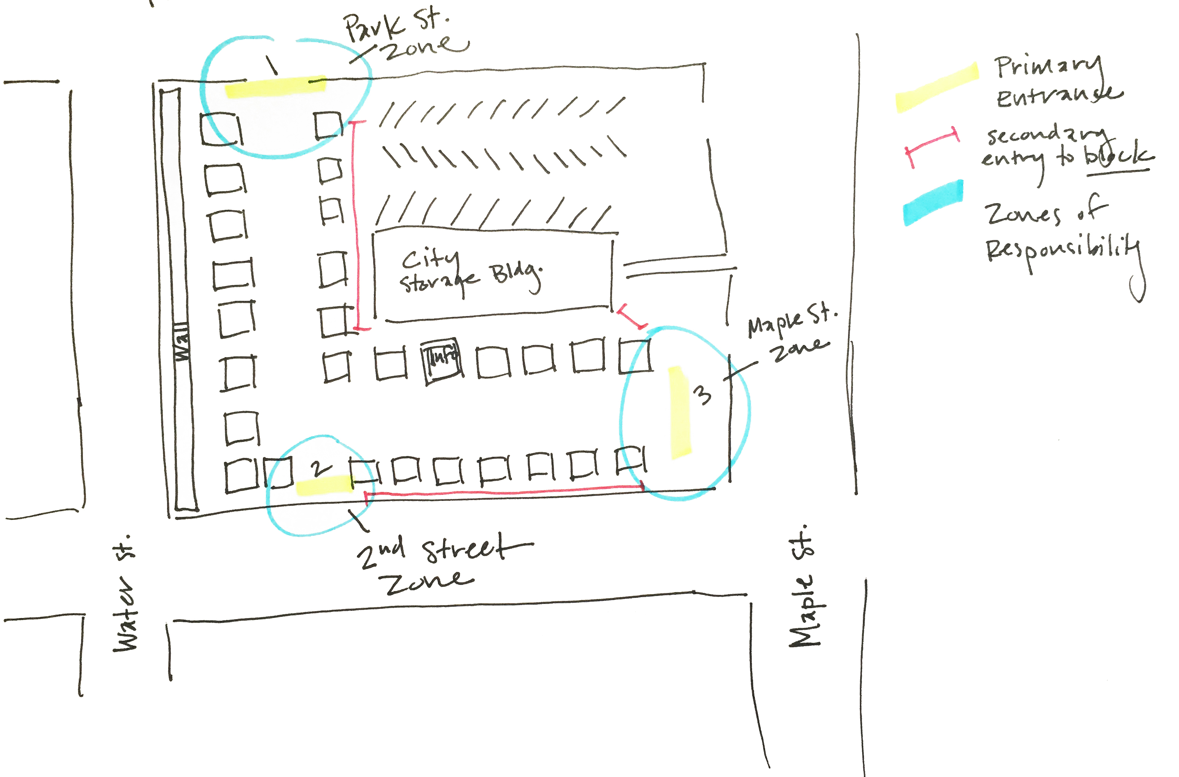
Parallel rows: L shape
Notes:
Oval/Square within an oval/square

Slide 14
Best: Most people can see the entire market, which we've found the vendors really appreciate. Worst: It's very spread out
68/1800
Notes:
Oval/Square within an oval/square

Slide 15
Best: Has a nice flow, customers walk the circuit, no vendor gets left out, music up at one end draws the customers, Information and activities/events at other end balance the energy Worst: difficult to count customers who seep through up by the music
60/2200
Notes:
Urbana IL

Slide 16
Best: Balance of vendor and shopper needs with available space Worst: Limited available space
43/2900
Notes:
3 things to consider: shopper flow, vendor comfort and risk management. How would you rate this map on those 3 areas? How about the live music set up in terms of vendor comfort? Pleasantville NY

Slide 17
Best: We don't have to close off a lot of streets; No mud or mess as it's an asphalt parking lot. Worst: It's a parking lot with limited room for growth or change in layout.
85/5000+
Notes:
Urbana IL Both rows and racetrack!

Slide 18
X, parallel, racetrack
X or + grid : flexible, more entrances, bad sight lines; shopper circuit often incomplete; experienced shoppers use easily; difficult for new managers to supervise.
Parallel rows: Least flexible, fewer entrances to manage, good sight lines, shopper circuit can be less than complete; good for new shoppers, easy for new managers to supervise
Closed Loop or Racetrack: Somewhat inflexible, angles are hard to work with, okay sight lines, longer shopper circuit, 100% locations; spacing can be tricky
Notes:
Sales-per-square-foot (most common, racetrack and
boutique layout)
– Sales-per-linear-foot (e.g., supermarkets, drug
stores, etc. with long gondolas in grid layout)
– Sales-per-cubic-foot (e.g., wholesale clubs with
multiple layers of merchandise)

Slide 19
Best and worst
Large market? (40+ vendors and 3000 + visitors)
Best layout? Worst layout?
Medium (+15- 40 vendors, 350-1500 visitors)
Best layout? Worst layout?
Micro market? (-15 vendors and -300 visitors)
Best layout? Worst layout?
Notes:
My vote for best for large: x or cross; worst: linear
My vote for best for medium: racetrack; worst Plus
My vote for best for small oval; worst x

