Slide 1
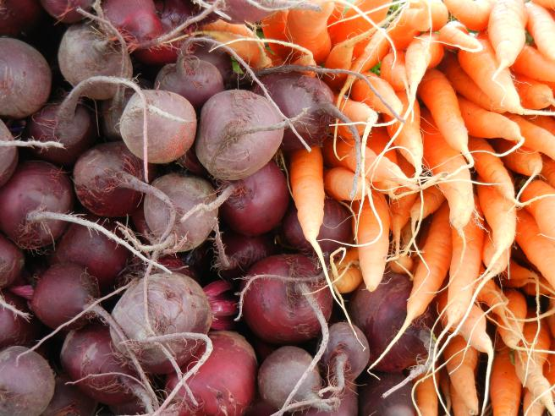
Back to Basics: Everything You Need to Know About 3SquaresVT
Presented by Katie Green, Adult Nutrition Initiatives Specialist
Notes:
Hello Everyone, my name is Katie Green and I am the Adult Nutrition Initiatives Specialist at Hunger Free Vermont. We are VT’s statewide education and advocacy organization with the mission of eliminating hunger and malnutrition for all Vermonters. At HFVT, I work on the 3SquaresVT (also known as SNAP and Foodstamps) program. This presentation will dive into the basics of the 3SVT program- why we have it, how it works, and the many ways it helps our farmers markets and state as a whole.

Slide 2
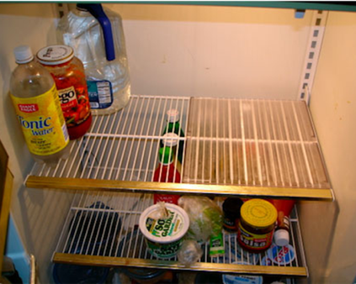
Hunger in Vermont
1 in 9 Vermonters (11%) are considered “food insecure,” meaning they lack consistent access to enough food. This includes 1 in 7 children.
Many factors contribute, including issues of income, education, and health.
Many consequences, physical, social and economic, result for the individual and society.
3SquaresVT helps decrease hunger and food insecurity.
Notes:
Before we start to discuss 3SVT- I want to open by talking about the problem of hunger in VT
1 in 9
Recent USDA surveys show that hunger has been declining for most people over the past few years. Between 2010-2015 food insecurity for all Vermonters dropped by 23%, for Vermont children food insecurity dropped by 37%. Part of this is due to an improving economy but it’s also due to Vermont’s investment in and continued efforts to strengthen nutrition programs that feed Vermont’s children. Unfortunately, seniors did not see a drop in food insecurity, they have actually experienced a substantial rise in hunger as the population of Vermont continues to age and senior meal programs continue to be underfunded.
Nation’s first line defense against hunger

Slide 3
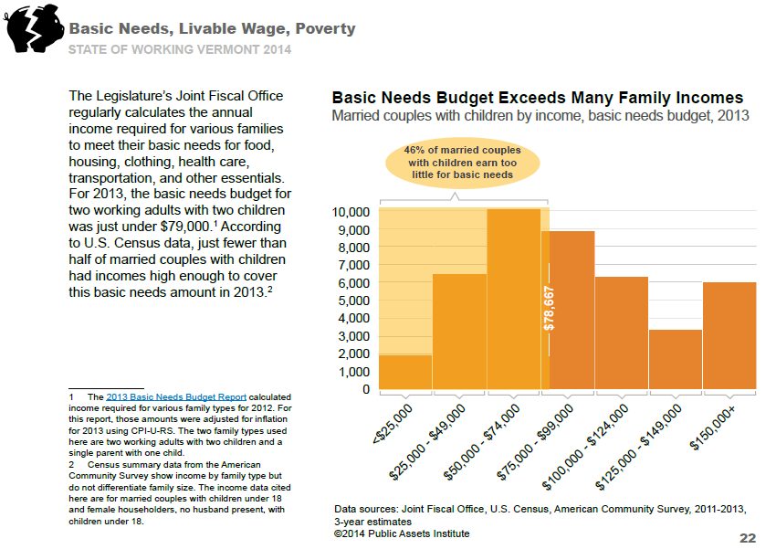
Notes:
What we know is that many Vermonters struggle to meet their Basic Needs. According to a report from the Joint Fiscal Office in 2014, approximately 46% of married couples with children earn too little to meet all of their basic needs.

Slide 4
What is 3SquaresVT?
A nutrition program of the US Department of Agriculture, originally piloted in 1939 and designed to alleviate hunger.
Nationally known as the Supplemental Nutrition Assistance Program or SNAP.
The VT Department for Children and Families Economic Services Division processes applications and issues benefits.
3SquaresVT is a federal entitlement program. Everyone eligible is entitled to its benefits.
Notes:
One of the most important things to know about 3SVT is that it is an entitlement program, which means that everyone who is eligible is entitled to benefits. 3SVT is one of the few entitlement programs left- many other benefit programs are block granted and only have a set pot of money to fund the entire program…so when that money runs out you can be denied even if you are eligible. We hear, especially from seniors, that they don’t want to apply for the program because they are worried they will take benefits away from a family with kids that might need it more. But that is not how the program works- everyone who is eligible is entitled to benefits. This is one of the strongest aspects of the program as it can respond very quickly to changes in the economy.
A few key points to remember:
USDA Program: designed as a nutrition program, to help farmers sell their food and help people eat better
Administered by State: Federal program with federal rules, but it is the State that people apply to and the state distributes the benefits. In Vermont, it’s the Department for Children and Families.

Slide 5
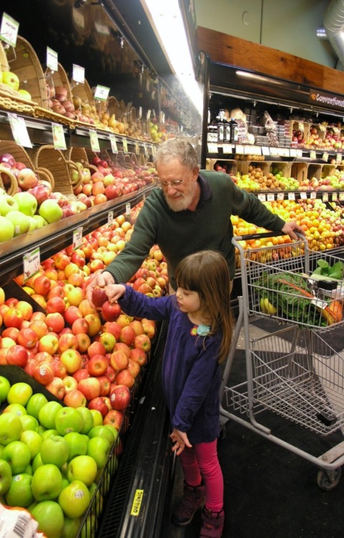
Who is 3SquaresVT for?
Families, individuals, children, seniors, people with disabilities, working, unemployed, etc.
3SquaresVT is an entitlement; everyone eligible is entitled to its benefits.
Notes:
So, who is 3SVT for? It’s so for everyone who qualifies- Families, individuals, children, seniors, people with disabilities, working, unemployed, etc.
One of the most important things to know about 3SVT is that it is an entitlement program, which means that everyone who is eligible is entitled to benefits. 3SVT is one of the few entitlement programs left- many other benefit programs are block granted and only have a set pot of money to fund the entire program…so when that money runs out you can be denied even if you are eligible. We hear, especially from seniors, that they don’t want to apply for the program because they are worried they will take benefits away from a family with kids that might need it more. But that is not how the program works- everyone who is eligible is entitled to benefits. This is one of the strongest aspects of the program as it can respond very quickly to changes in the economy.

Slide 6
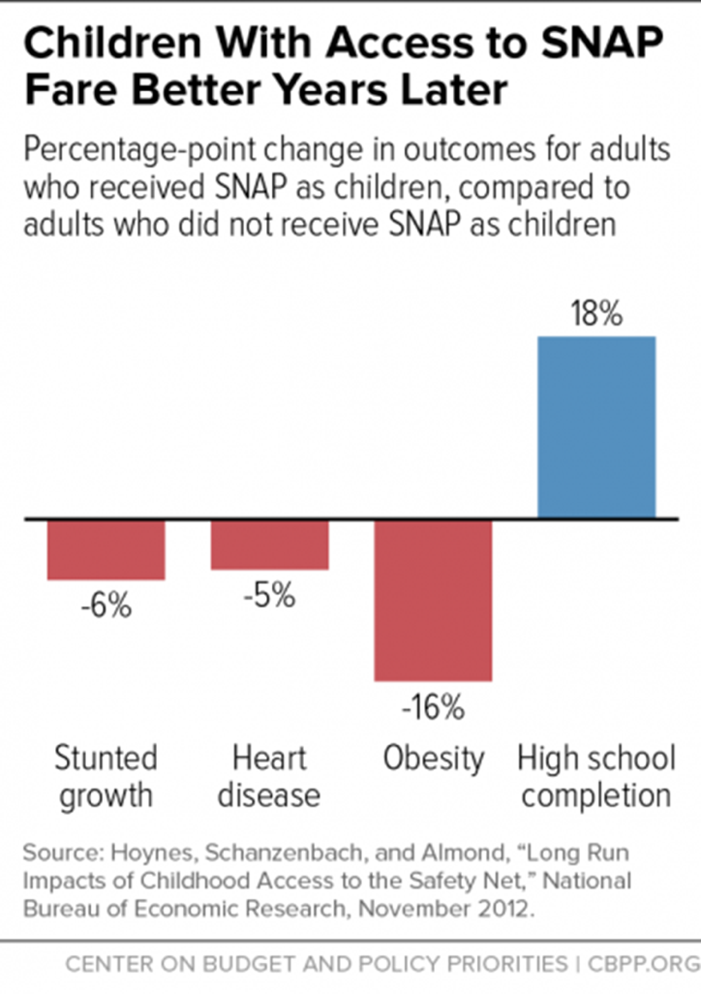
Notes:
We know that 3SVT/SNAP is a very effective program. There are various data points that attest to SNAP’s powerful impact but this is one of my favorites. Recent data from the Center on Budget and Policy Priorities found that adults who received SNAP as children were 18% more likely to graduate from HS than adults who didn’t have access to SNAP as children. The report also found That these same children that received SNAP were less likely to suffer from major health ailments including heart disease, obesity, and stunted growth.

Slide 7
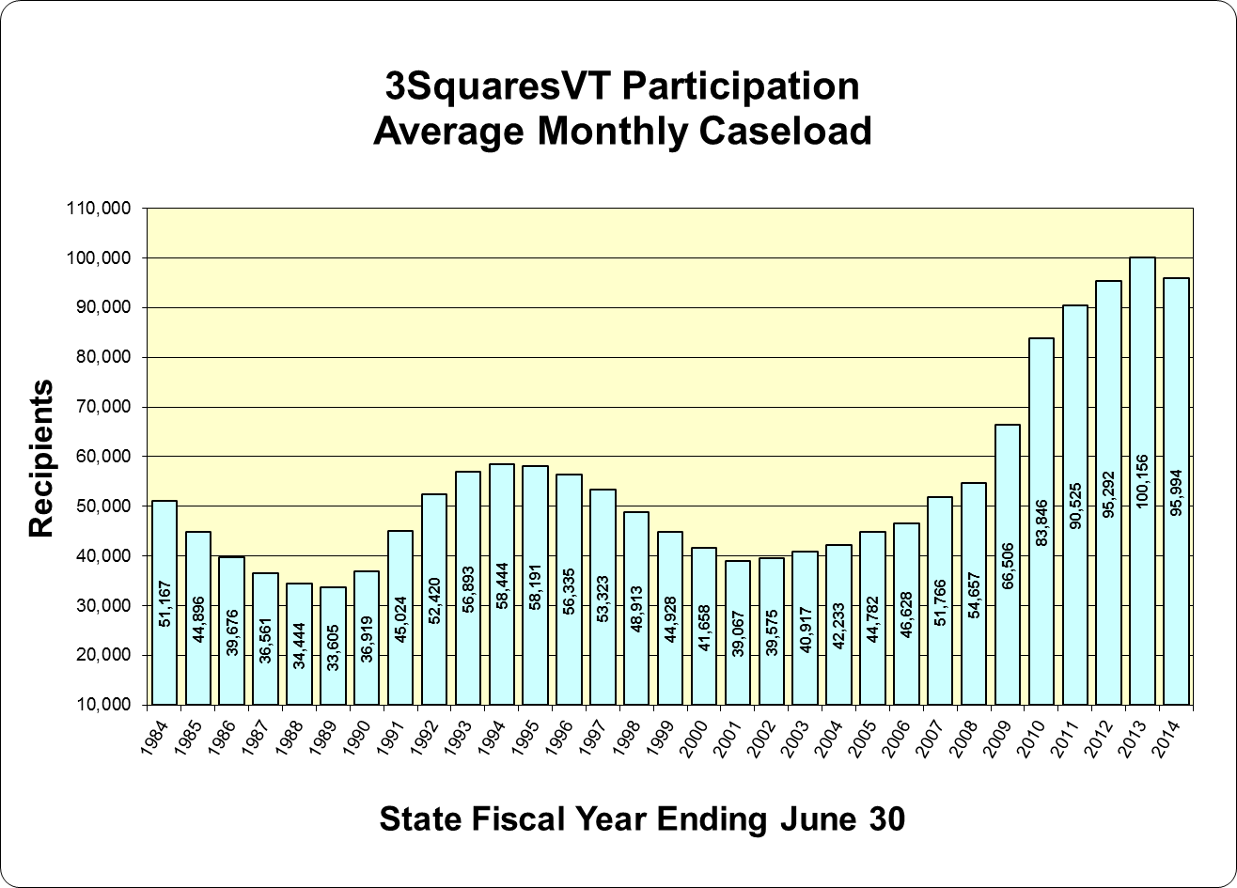
3SquaresVT Participation
Participation reached all-time high of 102,000 in January, 2013
Participation has been declining and is now at approx. 79,000
Average length of participation: 9 months to a year
1 out of 4 eligible Vermonters are not participating
Notes:
A common myth about SNAP/3SquaresVT that gets perpetuated in the media is that this is a program for people who just don’t want to work. Like many other myths about the this program, its just simply not true and we have strong data points to back that up. The largest recipient group that benefits from this program at both the state and national level is children. In VT, children make up 34% of 3SVT recipients. 26% are disabled individuals, 18% are seniors, and 22% are non-disabled adults. We also know that many 3SVT HH are working HH who have to turn to the program in an economy that often doesn’t pay living wages or wages that allow families to meet all of their basic needs.

Slide 8
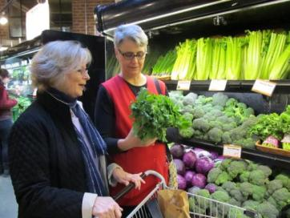
What can participants buy with 3SquaresVT?
Breads and cereals
Fruits and vegetables
Meats, fish and poultry; and
Dairy products
Seeds and plants which produce food for the household to eat
Key tenets of program are hunger alleviation and food choice.
Notes:
One of the reasons the name changed is USDA and VT want to emphasize that this is a food program designed to improve nutrition. Thus, non-food items are not allowed to be purchased with 3Squares benefits.
Another important aspect of the program is food choice – having the same food options as other shoppers – because this is shown to increase participation whereas limitations decrease participation nor is there research to show that limitations would improve nutritional outcomes.
3SquaresVT encourages but does not mandate healthy food choices. Primarily this is done through nutrition education, which has shown to improve nutrition over time.
**No hot prepared foods!!**

Slide 9
How does it work?
There Are No Food Stamps
Electronic Benefits Transfer (EBT) debit-like card – more efficient & anonymous
Automatic monthly deposit onto card on 1st of month
Benefits remain on card up to 1 year
To be used anywhere EBT is accepted in USA - 600+ retailers in VT, 40+ farmers’ markets
Important: card may contain other benefits like Reach Up or General Assistance
Households where all members are seniors 65+ or SSI recipients get benefits as cash in their bank accounts
Notes:
So how exactly does 3SVT work? Folks no longer get physical food stamps to buy food with, rather- benefits are deposited onto an Electronic Benefits Transfer Card (EBT card) in a more efficient and anonymous process. Benefits are deposited onto the card on the 1st of every month and although they will stay on the card for up to 1 year, we frequently here that most families go through their benefits before the end of the month. Benefit amounts are low and families really struggle to stretch these benefits for as long and as far as they will go.
Other benefits on EBT card: Emergency/General Assistance (for income eligible Vermonters who need assistance covering basic needs- fuel, rent, personal needs, etc.) , Essential Person (for Vermonters that are blind, disabled, 65+ and meet income guidelines- it provides funds to help them stay in home by paying for someone to live in and provide care), Reach Up (for eligible parents to gain job skills to support minor dependent children)

Slide 10
EBT Card
EBT Food
EBT Cash
No cash change given, only SNAP-eligible food
Cash change given, can buy anything
Notes:
The EBT Card contains two categories- EBT Cash and EBT food. The large majority of 3SquaresVT recipients receive their benefit deposited as EBT Food on their EBT card. The second category, EBT Cash is mostly for programs like Reach Up, General Assistance, or Essential Person. Money loaded onto the card as EBT Cash can be used for a wider array of purchases (not just SNAP eligible foods- it can be used to pay rent, buy toothpaste, to put gas in the car, etc) with some restrictions, at stores and can be used at farmers markets. And again, while most people get their 3SquaresVT benefit deposited as EBT Food onto an EBT Card, a small population of Vermonters are eligible to get their benefit deposited directly into their bank account. HHs where all members are 65 or older or HHs where all members receive SSI can get their benefits deposited into their bank account. The first month they are on the program, they will receive their benefits as EBT CASH on an EBT card before the benefits begin to be directly deposited the next month. AND if an all senior or all SSI HH doesn’t have a bank account, they will continue to get their 3SVT benefit deposited as CASH on an EBT card.
So when you process an EBT card you will be prompted to select one of these options and ask the customer which one they are using. If the person isn’t sure of the difference, ask them if they get 3SquaresVT/food stamps and if they’d like to use those benefits. If someone is using EBT Food they will receive $1 tokens that can only be used on food approved by the 3SVT program (so no hot prepared foods or alcohol/crafts/art sold at the market). No cash change can be given for $1 tokens so shoppers must buy things to the nearest one dollar amount. If someone is using EBT CASH (whether that is their 3SVT benefit deposited as cash or another benefit program) they get the $5 tokens which can be used to buy anything at the market- they can also receive cash change for the $5 tokens. There is an exception to this rule for 3SVT HH that have an EBT Cash benefit and want to get Crop Cash which we will talk about more in depth later on. And while 3SVT recipients who get their benefit deposited as EBT CASH on a card or into their bank accounts can get crop cash- Crop cash does NOT match the other program benefits that come loaded onto this card like Reach UP and GA or Essential Person. Crop cash only matches 3SquaresVT- but again we will talk about this later.

Slide 11
Maximum Benefits
There is a maximum monthly benefit for each household size:
Household Size | Max Benefit
1 | $194
2 | $357
3 | $511
4 | $649
5 | $771
6 | $925
Notes:
3SquaresVT/SNAP is not a program that is intended to cover all of someone’s food costs, as the name states- it is intended to be a supplement. But since many families have competing financial priorities including the high cost of living/child-care/health-care/student loans…many rely on their 3SVT benefit to purchase all their groceries.
One of the limitations of SNAP is that benefit amounts are low, many families report running out of benefits before the end of the month. Often times cheaper less nutritious food is more cost effective and less time intensive than purchasing and preparing healthy local produce. This is part of the reason why the USDA distributes the FINI grants that help fund Crop Cash and programs like Crop Cash across the country…

Slide 12
Crop Cash, Farm to Family & Incentive Programs
Notes:
And this is where Crop Cash and other incentive programs come in. Because benefit amounts are low and healthy food is often out of reach for many folks using 3SVT- programs like Crop Cash and Farm to Family have been created to make produce more affordable.

Slide 13
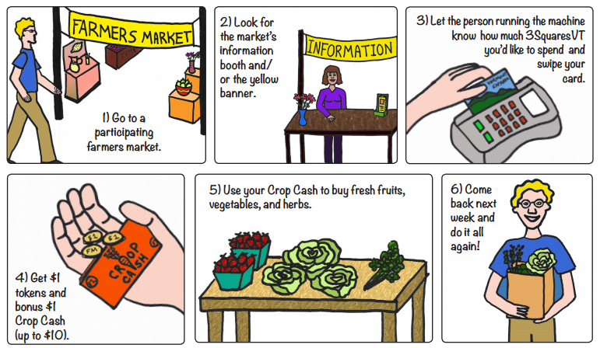
Crop Cash: How it Works
Notes:
Crop Cash is a FINI (food insecurity nutrition incentive) funded project. The FINI grant program was established by the 2014 Farm Bill to make health produce more accessible for SNAP/3SVT clients. Hundreds of FMs, and other retailer food stores participate in FINI grant projects throughout the country.
CC incentivizes fresh fruits and vegetables (**which includes SNAP eligible seeds and plants intended for cultivation and consumption (ex. Tomato seeds/tomato plants) AND fresh herbs (fresh basil, fresh thyme, etc.). It’s now in its third year in Vermont and replaced the Harvest Health program (which was similar but HH coupons could be used to buy any SNAP eligible foods- not just fruits, veggies, and plants/starters.
1) All markets that accept EBT ALSO offer CC
2) Important to have an approachable information booth!
3)**special rules for seniors reminder
4) Tokens must be used at that Farmers Market
5) Again, reminder that plant seeds/starts are CC eligible. **NO CASH CHANGE FOR CC COUPONS
6) No limit to the number of markets a person can go to in a day/week/season…but they can only get $10 per individual market day

Slide 14
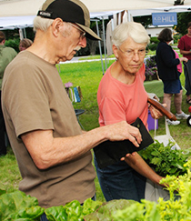
Crop Cash for Seniors and SSI Households
Since Seniors (65+) or people with disabilities on SSI don’t always have EBT cards, Crop Cash works on an honor system.
Seniors can approach the market manager tent and let the person know they are using X amount of dollars in 3SquaresVT benefits and that they’d like to get Crop Cash coupons. If they want to get Crop Cash coupons they will get $1 tokens.
Notes:
Again, there are special rules surrounding households in which all members or seniors or all SSI recipients. These households are eligible to receive their 3SquaresVT benefit deposited as cash into their bank accounts. However, there are two caveats to this. For the first month a senior or all SSI household receives benefits, those benefits will come as EBT cash on an EBT card. After the first month, the benefits will begin to be deposited into the person’s bank account. The second caveat if that some folks may not have a bank account- in this case the senior or all SSI household would continue to receive their 3SquaresVT benefit as EBT cash on an EBT card.
So how do these folks get Crop Cash? Essentially its an honor system. If someone approaches the booth with an EBT card and says they are using their 3SquaresVT benefit that gets deposited as Cash on their card, they don’t need to prove that. You can given them $1 tokens for however many benefit dollars they want to spend and then give them up to $10 in matching Crop Cash coupons.
For the folks that get their benefit deposited as cash into their bank account and don’t have an EBT card- they would approach the market booth, let the person know they will be shopping with their 3SVT benefits and would exchange their physical cash for $1 tokens and then get the matching amount of CC coupons.
Direct deposit, cash benefit used for food
*get tokens for actual cash too

Slide 15
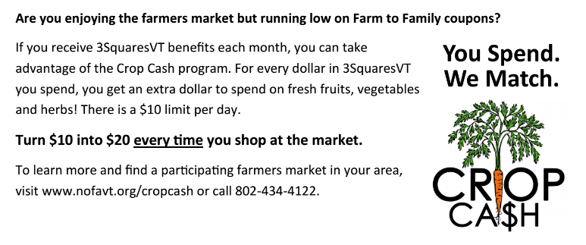
Farm to Family: How it Works
Administered by Vermont Department for Children and Families
Helps folks buy locally-grown fresh fruits and vegetables
WIC families & income eligible individuals, families, and seniors apply in late June
$30 in coupons
Notes:
Income eligibility: at or below 185% FPL
WIC families apply at F2F special sessions at local District Health Office
Other HHs apply through their local Community Action Agency
Coupons are valid for one market season and expire on October 31st
Another program that helps our low-income neighbors access healthy local produce is the F2F program. It is administered by the Department for Children and Families and serves WIC families and income eligible individuals, families, and seniors. In order to receive F2F, folks need to apply in late June at their local District Health office if they receive WIC or at their Local Community Action Agency if the don’t receive WIC but are at or under 185% of the Federal Poverty Level. After folks apply they are given a book with $30 in coupons to spend on locally grown fresh fruits and veggies. The coupons need to be used during that market season before they expire on October 31st. This year DCF is including information about Crop Cash on the back page of the F2F coupon booklet in an effort to make sure all potentially eligible folks know the CC exists and can continue to help them put healthy produce on their table.

Slide 16
3SquaresVT Helps Communities
Improved health outcomes leads to decreased healthcare costs.
Children perform better in school and become more productive adults, leading to increased social and economic stability.
3SquaresVT stimulates the economy:
Every $1 in 3SquaresVT benefits generates about $1.70 in economic activity.
Notes:
*3SquaresVT is also a program that helps the community and state at large
Brings $125 million into VT economy every year

Slide 17
3SVT and Crop Cash Help Farmers Markets
Summer 2016
SNAP Transactions: 5,846
SNAP Sales: $73,085
+
Crop Cash Redeemed: $52,044
$125,129

Slide 18
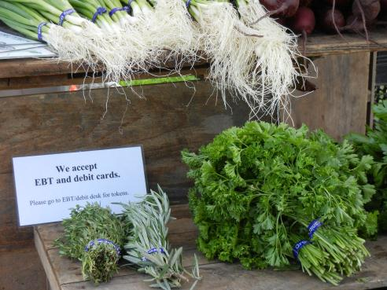
Barriers To Shopping at Farmers Markets
Lack of knowledge of when/where to find market.
Lack of knowledge that EBT is accepted and how to use it.
Lack of transportation to market.
Market not at convenient time/location.
Perception that market is too expensive.
Unfamiliarity with produce & storage/prep/cooking.
Unfamiliarity with market culture & benefits of shopping at the market.

Slide 19
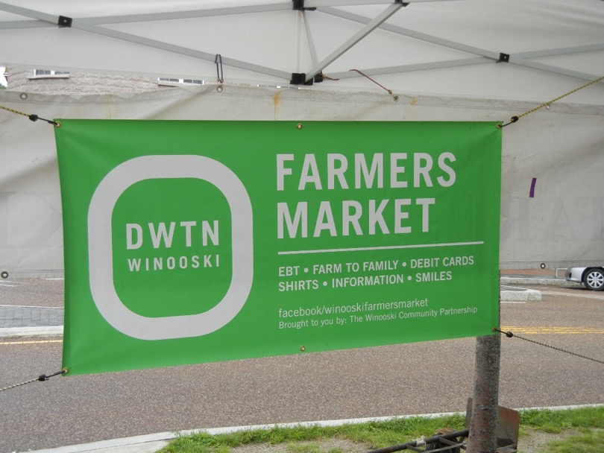
Outreach Strategy #1: Create a welcoming environment
Signs should be clear and visible, both for market and for vendors.
EBT booth should be easy to find, well marked.
Consistent and friendly staff at EBT booth ready to help explain how EBT/tokens work & answer questions.
Provide free samples/recipes if possible.
Any advertisements for market (including social media) should include “EBT accepted” message.

Slide 20
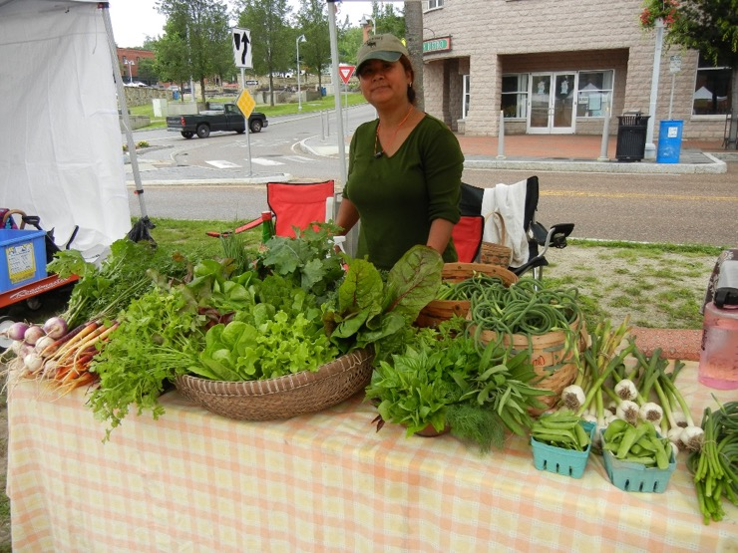
#2: Connect with Key Agencies in Community
Many social service agencies are unaware of EBT and Crop Cash coupons at the farmers’ market: They are your key allies in community.
WIC, Community Action, Agency on Aging, food shelves, shelters, housing sites, libraries, hospitals/health clinics/doctors, schools, child care centers, summer schools, summer programs, etc.
Share outreach posters, flyers, etc. Presentations are great, too. Connect with farm to community mentors to broaden your reach.

Slide 21
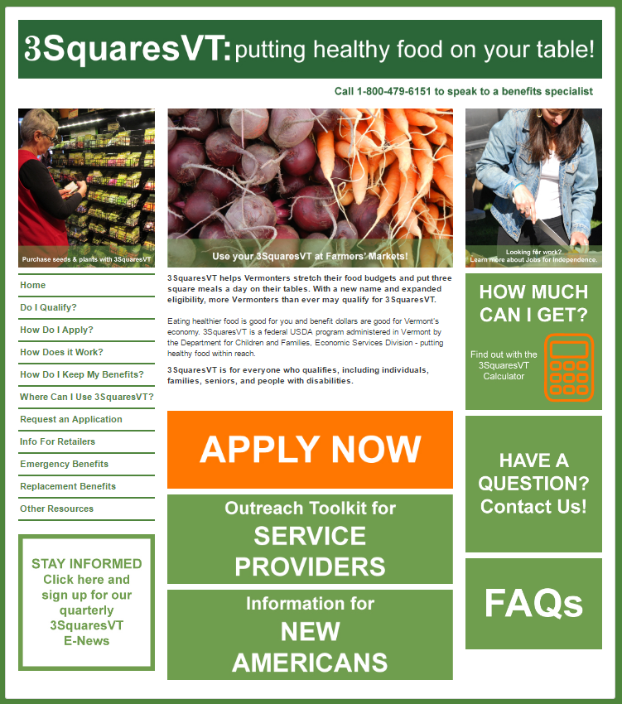
Tools You Can Use
www.vermontfoodhelp.com (comprehensive website about 3SquaresVT)
Posters, flyers, handouts, messages
3SquaresVT E-Update
(sign up now or anytime at www.hungerfreevt.org)
Contact Hunger Free Vermont at any time with questions!

Slide 22
Thank You!
Katie Green
Adult Nutrition Initiatives Specialist
Kgreen@hungerfreevt.org

